Slide 1
Data
Processing
Case
479 subjects
716,503 SNPs
Control
1,261 subjects
630,860 SNPs
Raw Data
Case
429 subjects
566,115 SNPs
Control
1,261 subjects
574,709 SNPs
Quality Control
Combined Data
1,690 subjects
558,124 SNPs
Combining Datasets
Combined Data
1,681 subjects
549,599 SNPs
Quality Control
GWAS
Single SNP-based Logistic Regression
Phase 1
Constructing LD Blocks
Phase 2
Haplotype Analysis
eQTL Mapping
Phase 3
Haplotype-based Logistic Regression

Slide 2
Data Processing
GWAS
Case
479 subjects
716,503 SNPs
Control
1,261 subjects
630,860 SNPs
Single SNP-based Logistic Regression
Phase 1
Raw Data
Case
429 subjects
566,115 SNPs
Control
1,261 subjects
574,709 SNPs
Constructing LD Blocks
Phase 2
Quality Control
Combined Data
1,690 subjects
558,124 SNPs
Haplotype Analysis
eQTL Mapping
Phase 3
Combining Datasets
Combined Data
1,681 subjects
549,599 SNPs
Haplotype-based Logistic Regression
Quality Control

Slide 3
Data Processing
Case
479 subjects
716,503 SNPs
Control
1,261 subjects
630,860 SNPs
Single SNP-based Logistic Regression (SLR)
Single SNP-based Conditional Logistic Regression (SCLR)
Raw Data
Quality Control
Case
429 subjects
566,115 SNPs
Control
1,261 subjects
574,709 SNPs
Constructing LD Blocks & Imputation
Identifying TADs using Hi-C data
Combining Datasets
Combined Data
1,690 subjects
558,124 SNPs
Epigenetic Mapping
eQTL Mapping
Quality Control
Combined Data
1,681 subjects
549,599 SNPs
Integrating Results

Slide 4
Data Processing
Case
479 subjects
716,503 SNPs
Control
1,261 subjects
630,860 SNPs
Single SNP-based Logistic Regression (SLR)
Single SNP-based Conditional Logistic Regression (SCLR)
Raw Data
Quality Control
Case
429 subjects
566,115 SNPs
Control
1,261 subjects
574,709 SNPs
Constructing LD Blocks & Imputation
Identifying TADs using Hi-C data
DEG analyses using RNA sequencing data
Combining Datasets
Combined Data
1,690 subjects
558,124 SNPs
Integrating ChIP-seq data
GO enrichment analyses
Quality Control
Combined Data
1,681 subjects
549,599 SNPs
Integrating Results

Slide 5
GO Term | Description | P-value | FDR q-value
GO:0040011 | locomotion | 5.620E-11 | 1.012E-09
GO:0016477 | cell migration | 1.720E-09 | 1.548E-08
GO:0048870 | cell motility | 7.310E-09 | 4.386E-08
GO:0051241 | negative regulation of multicellular organismal process | 1.260E-08 | 5.670E-08
GO:0030334 | regulation of cell migration | 9.050E-08 | 3.240E-07
GO:0051270 | regulation of cellular component movement | 1.090E-07 | 3.240E-07
GO:0033993 | response to lipid | 1.260E-07 | 3.240E-07
GO:0040012 | regulation of locomotion | 2.040E-07 | 4.590E-07
GO:2000145 | regulation of cell motility | 2.380E-07 | 4.760E-07
GO:0014070 | response to organic cyclic compound | 3.310E-07 | 5.958E-07
GO:0009888 | tissue development | 1.320E-06 | 2.160E-06
GO:0009719 | response to endogenous stimulus | 1.020E-05 | 1.530E-05
GO:0009725 | response to hormone | 3.070E-05 | 4.024E-05
GO:0008285 | negative regulation of cell proliferation | 3.130E-05 | 4.024E-05
GO:0051248 | negative regulation of protein metabolic process | 6.510E-05 | 7.812E-05
GO:0032269 | negative regulation of cellular protein metabolic process | 1.970E-04 | 2.216E-04
GO:0009653 | anatomical structure morphogenesis | 5.590E-04 | 5.919E-04
GO:0030336 | negative regulation of cell migration | 7.460E-04 | 7.460E-04

Slide 6
Data Processing
Case
479 subjects
716,503 SNPs
Control
1,261 subjects
630,860 SNPs
Single SNP-based Logistic Regression (SLR)
Single SNP-based Conditional Logistic Regression (SCLR)
Raw Data
Quality Control
Case
429 subjects
566,115 SNPs
Control
1,261 subjects
574,709 SNPs
Constructing LD Blocks & Imputation
Identifying TADs using Hi-C data
DEG analyses using RNA sequencing data
Combining Datasets
Combined Data
1,690 subjects
558,124 SNPs
Integrating ChIP-seq data
GO enrichment analyses
Quality Control
Combined Data
1,681 subjects
549,599 SNPs
Integrating Results

Slide 7


Raw
Data
Case
479 subjects
716,503 SNPs
Control
1,261 subjects
630,860 SNPs
Only overlapped SNPs
Case
479 subjects
619,797 SNPs
Control
1,261 subjects
619,797 SNPs
Pooled Data
1,690 subjects
558,124 SNPs
Quality
Controls
Per SNPs
- 11,702 SNPs
- 40 SNPs
Per SNPs
Missing genotype rate > 0.05
- 39 SNPs
- 8,495 SNPs
P-value of Fisher’s exact test < 1$×$10⁻⁵
P-value of HWE < 1$×$10⁻⁵
- 142 SNPs
- 45,009 SNPs
- 0 SNPs
Missing genotype rate > 0.95
MAF < 0.05
- 41,838 SNPs
- 30 SNPs
MAF < 0.05
Subject QC
- 34 subjects
- 0 subjects
Per individuals
not White
- 0 subjects
Missing genotype rate > 0.05
- 12 subjects
- 1 subjects
Outlier
IBS > 0.8
- 4 subjects
- 0 subjects
- 0 subjects
Missing genotype rate > 0.95 & IBS > 0.8
Case
429 subjects
566,115 SNPs
Control
1,261 subjects
574,709 SNPs
Pooled Data
1,689 subjects
549,599 SNPs

Slide 8

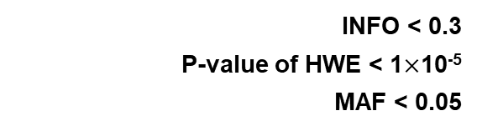

Case
479 subjects
716,503 SNPs
Control
1,261 subjects
630,860 SNPs
Raw
Data
Case
479 subjects
619,797 SNPs
Control
1,261 subjects
619,797 SNPs
Only overlapped SNPs
SNP QC
- 40 SNPs
- 39 SNPs
- 45,099 SNPs
Quality
Controls
Missing genotype rate > 0.05
P-value of HWE < 1$×$10⁻⁵
MAF < 0.05
- 11,702 SNPs
- 142 SNPs
- 41,838 SNPs
Subject QC
- 34 subjects
- 12 subjects
- 4 subjects
Non-White
Missing genotype rate > 0.05
IBS > 0.8
- 0 subject
- 0 subjects
- 0 subjects
Case
429 subjects
566,115 SNPs
Control
1,261 subjects
574,709 SNPs
Pooled Data
1,690 subjects
558,124 SNPs
Only overlapped SNPs
SNP QC
Quality
Controls
P-value of Fisher’s exact test < 1$×$10⁻⁵
Missing genotype rate > 0.05
MAF < 0.05
SNPs relevant to Nicotine dependence
- 8,495 SNPs
- 0 SNPs
- 30 SNPs
- 8 SNPs
Subject QC
Outlier (EIGENSTRAT)
Missing genotype rate > 0.05 & IBS > 0.8
Matching
- 3 subjects (3 cases)
- 0 subjects
- 409 subjects (409 controls)
Pooled Data
1,278 subjects
549,591 SNPs
Imputed Data
1,278 subjects
39,131,578 SNPs
Genotype
Imputation
SNP QC
Quality
Controls
INFO < 0.3
P-value of HWE < 1$×$10⁻⁵
MAF < 0.05
- 10,886,347 SNPs
- 2,596 SNPs
- 22,815,699 SNPs
Imputed Data
1,278 subjects
5,426,936 SNPs
Notes:
Only CLR subjects &

Slide 10
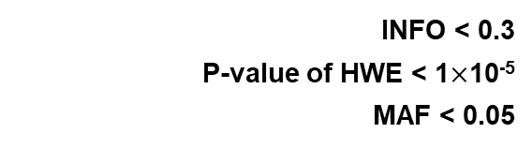
Pooled Data
1,278 subjects
549,591 SNPs
Imputed Data
1,278 subjects
39,131,578 SNPs
Genotype
Imputation
SNP QC
Quality
Controls
INFO < 0.3
P-value of HWE < 1$×$10⁻⁵
MAF < 0.05
- 0 SNPs
- 2,596 SNPs
- 33,701,644 SNPs
Imputed Data
1,278 subjects
5,427,338 SNPs
Notes:
Only CLR subjects &

Slide 11

Case
247 subjects
13 SNPs
Control
1,226 subjects
630,860 SNPs
Raw
Data
Case
247 subjects
13 SNPs
Control
1,226 subjects
13 SNPs
Only overlapped SNPs
SNP QC
- 0 SNPs
- 0 SNPs
Quality
Controls
Missing genotype rate > 0.05
- 1 SNP
- 0 SNPs
P-value of HWE < 1$×$10⁻⁵
- 0 SNPs
- 0 SNPs
MAF < 0.05
Subject QC
- 12 subjects
not NHW
- 27 subjects
- 0 subjects
Missing genotype rate > 0.05
- 0 subjects
Case
220 subjects
12 SNPs
Control
1,214 subjects
13 SNPs
Pooled Data
1,434 subjects
12 SNPs
Only overlapped SNPs
SNP QC
P-value of Fisher’s exact test < 1$×$10⁻⁵
- 1 SNP
Quality
Controls
Missing genotype rate > 0.05
- 0 SNPs
MAF < 0.05
- 0 SNPs
Subject QC
- 0 subjects
Missing genotype rate > 0.05
- 0 subjects
IBS > 0.8
Pooled Data
1,434 subjects
11 SNPs

Slide 12
Gene | CHR | start | end | Number of SNPs | P-value
NR2F2 | 15 | 96869157 | 96883492 | 5 | 0.0256
MCTP2 | 15 | 94774767 | 95027181 | 4 | 0.4949
SPATA8 | 15 | 97326619 | 97328845 | 3 | 0.5209

Slide 13
Prevalence |  | rs4544201 | rs2006950
10⁻⁶ | h_{SNP}²
10⁻⁵ | h_{SNP}²
10⁻⁴ | h_{SNP}²
10⁻³ | h_{SNP}²
10⁻² | h_{SNP}²

Slide 14
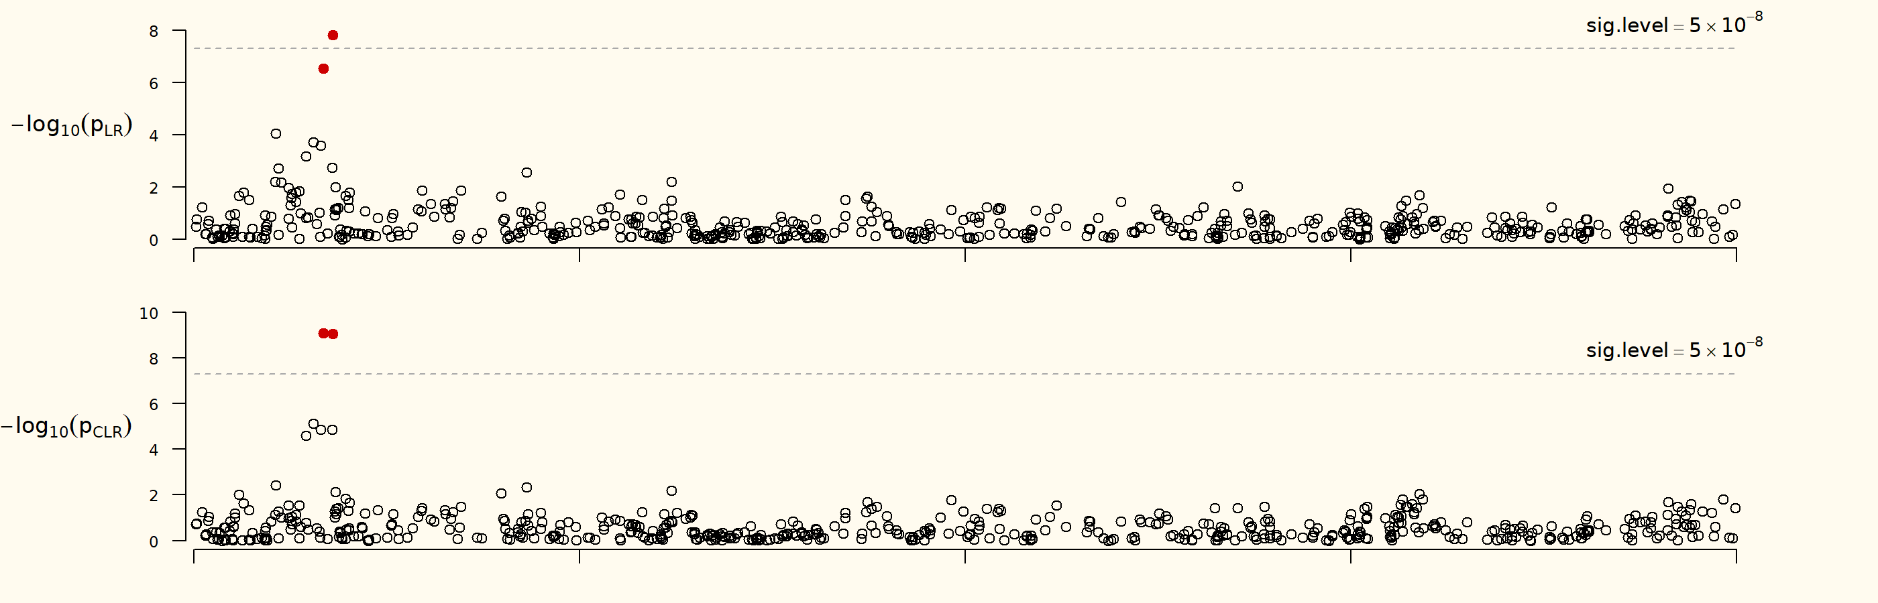
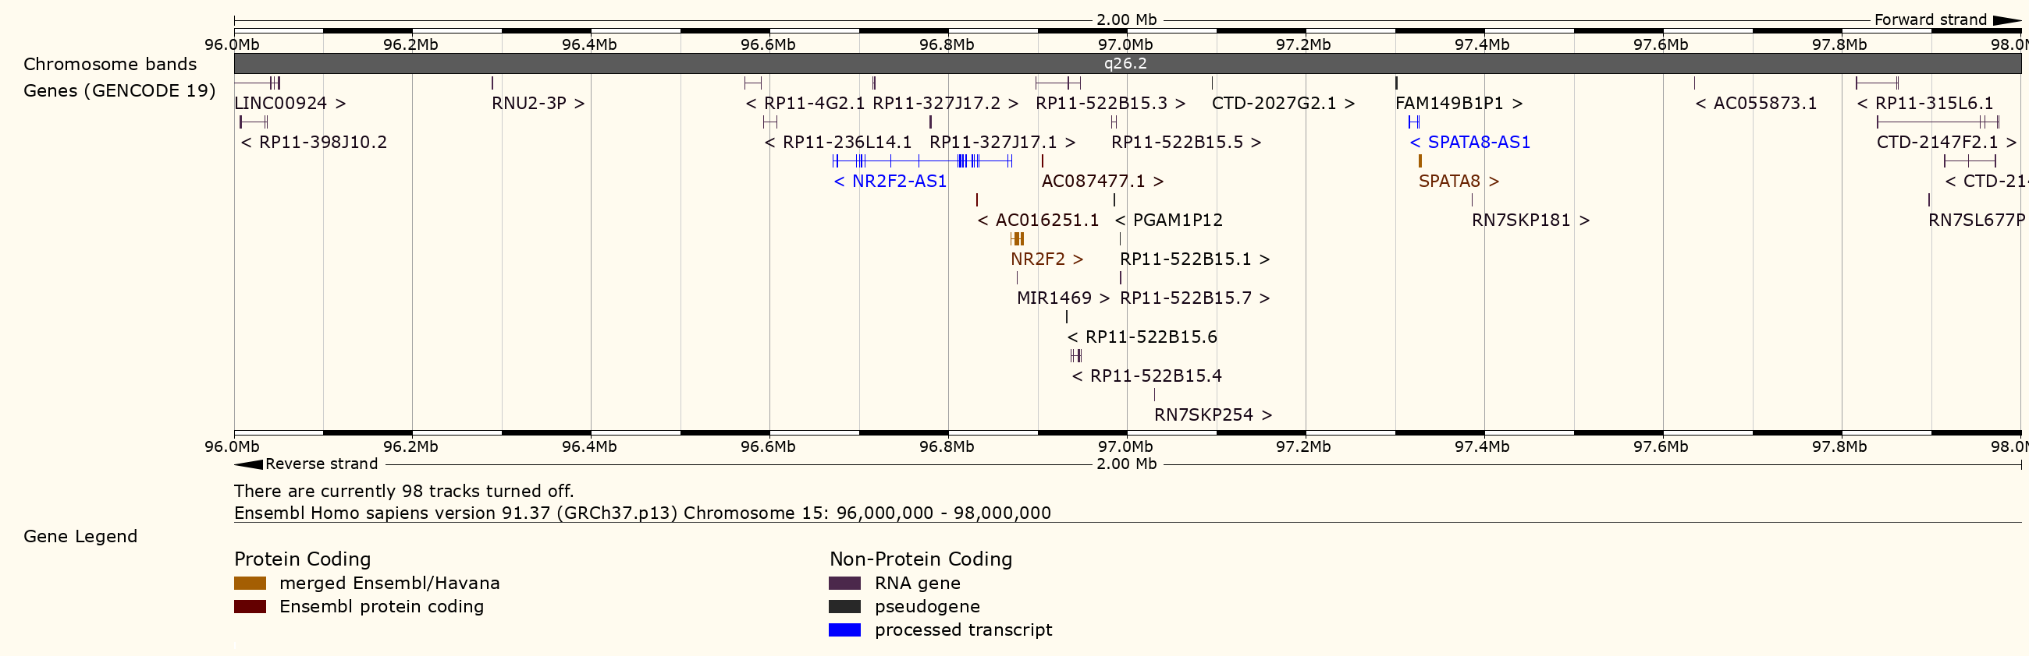
Chromosome 15

Slide 15
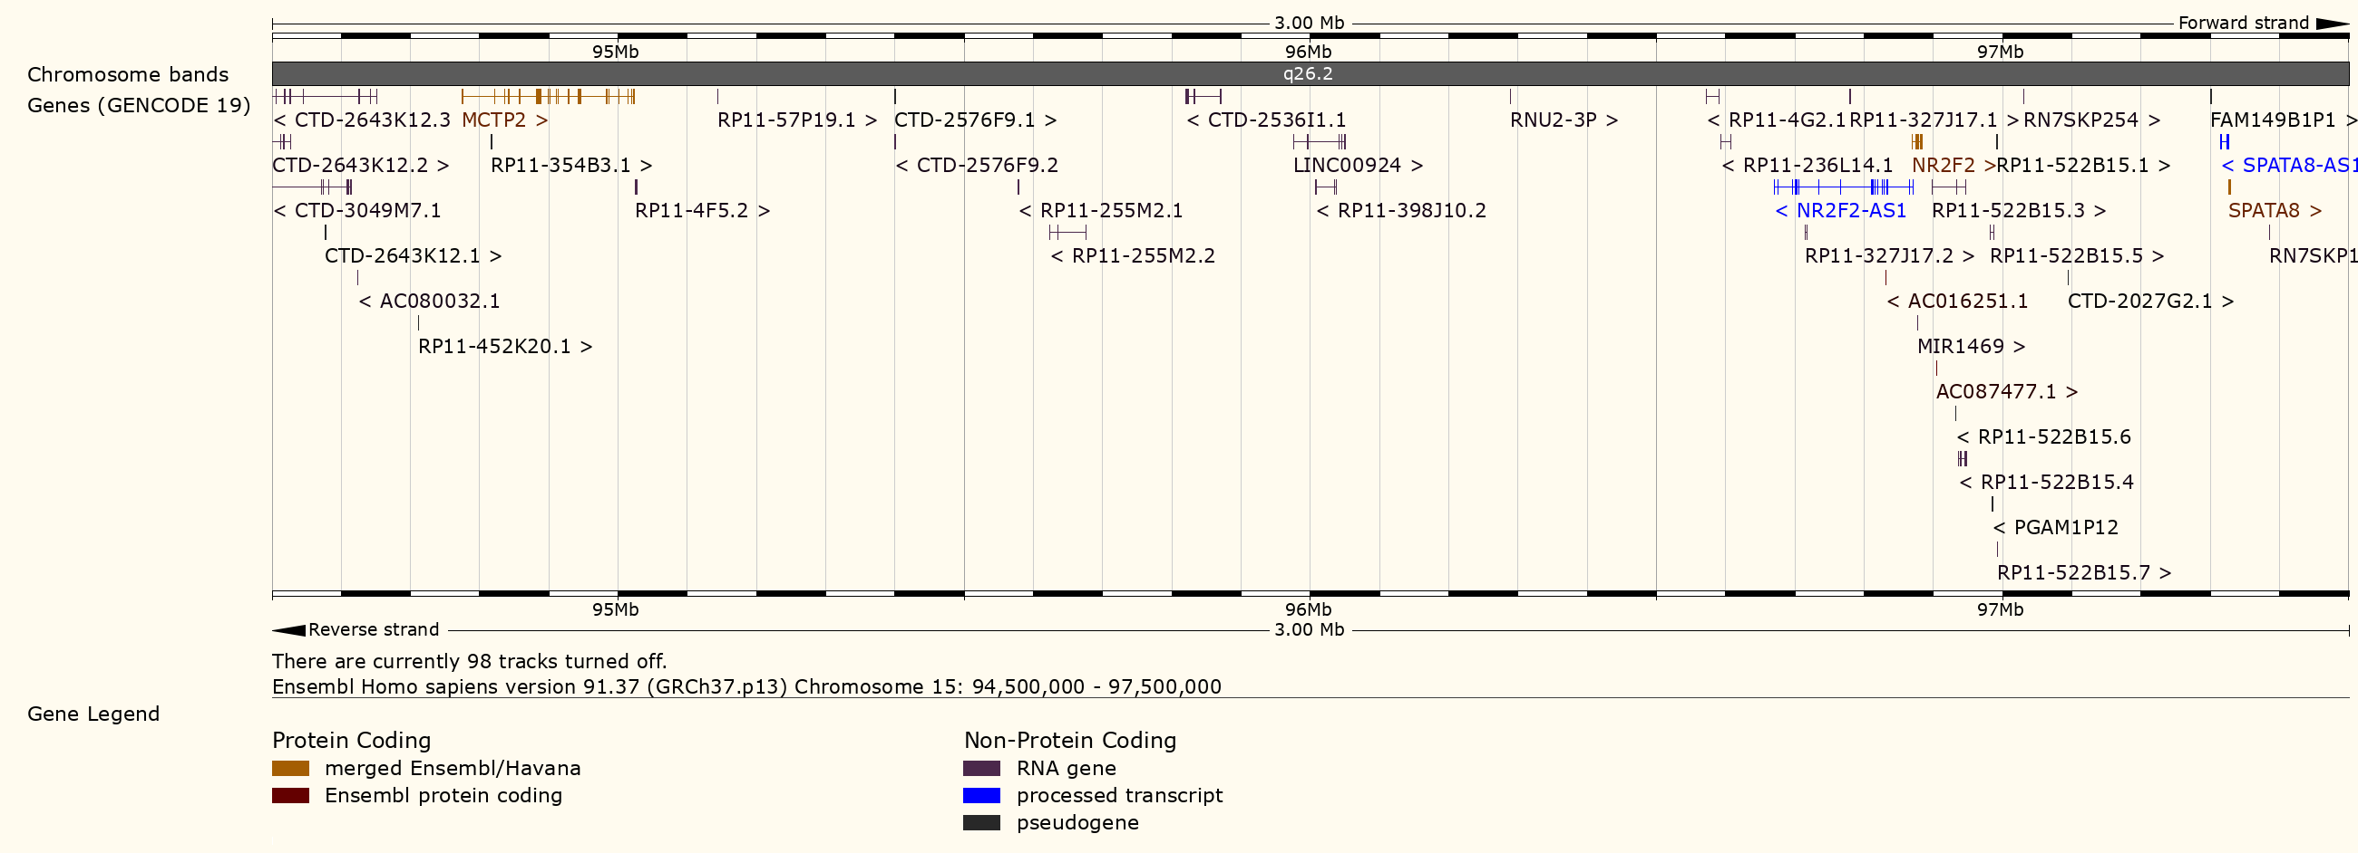
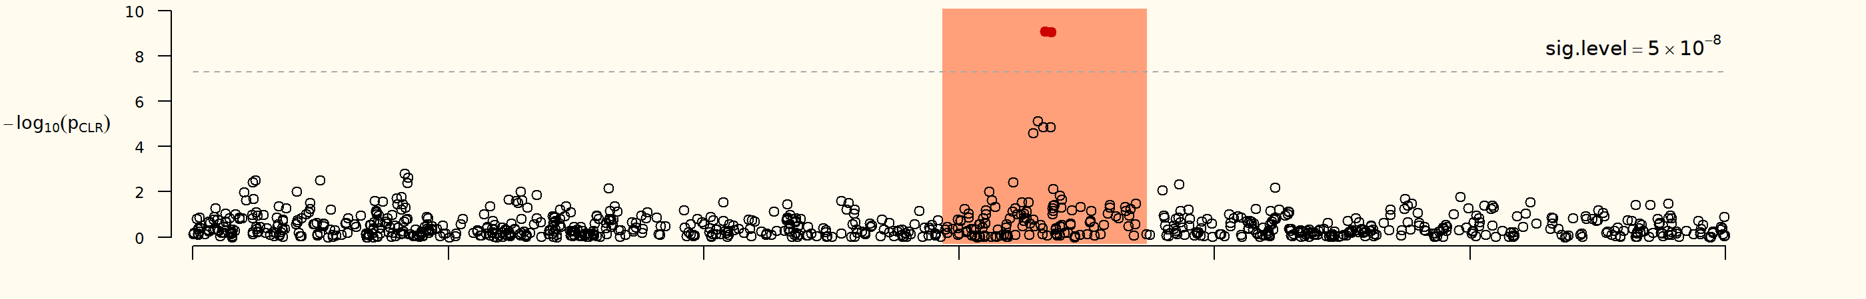
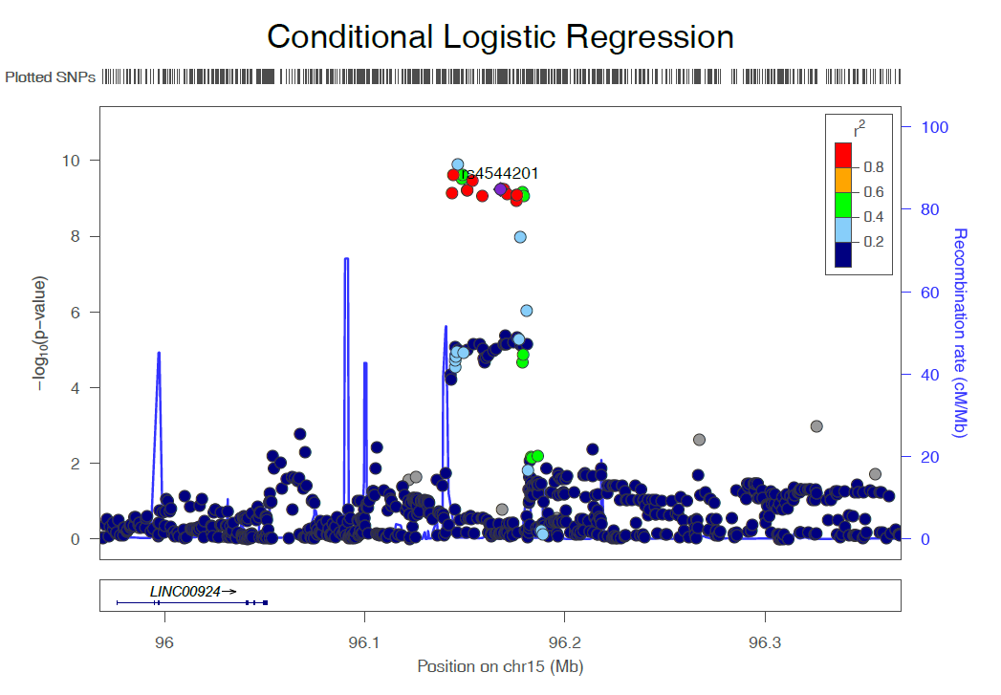
Chromosome 15
Genotyped + Imputed SNPs
Notes:
94500000-97500000

Slide 16
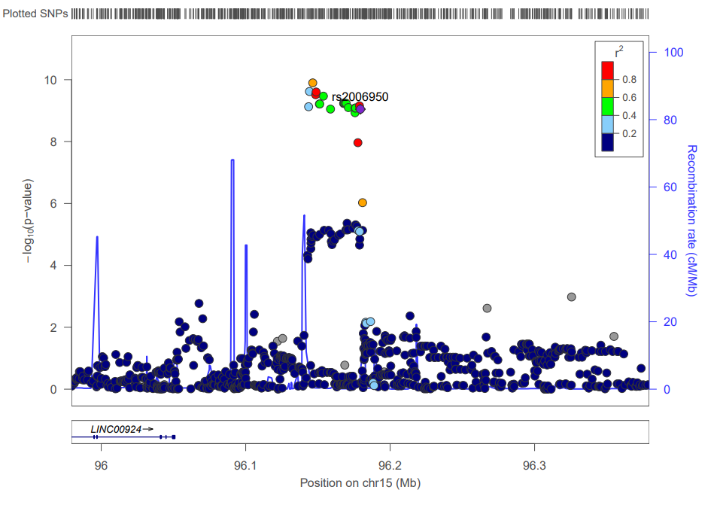
Chromosome 15
(A)
(B)
Genotyped + Imputed SNPs
Notes:
94500000-97500000

Slide 17
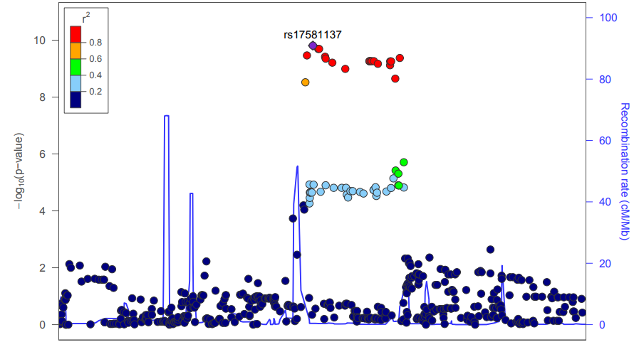
Chromosome 15
Genotyped + Imputed SNPs
Notes:
94500000-97500000

Slide 18
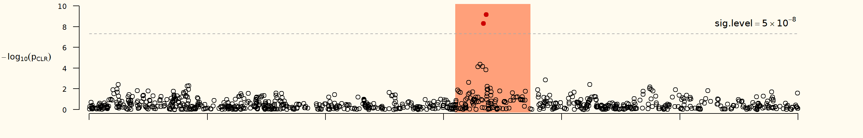
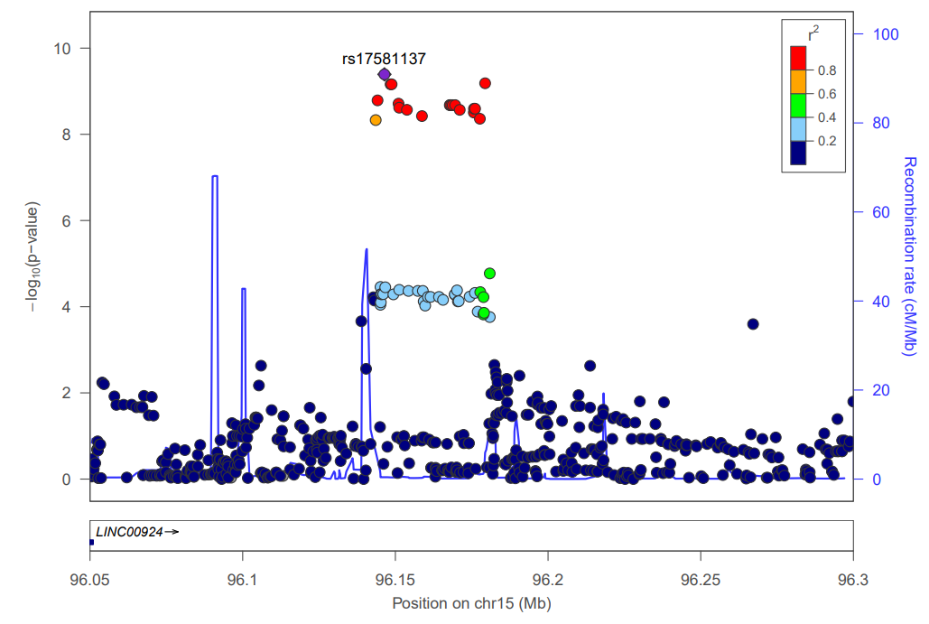
Chromosome 15
Genotyped + Imputed SNPs

Slide 19
CHR | PICS_SNPs | Position | PICS probability
 |  |  | rs4544201 | rs206950
15 | rs2006950 | 96179390 | 0.0162 | 0.2927
15 | rs4544201 | 96167827 | 0.1529 | 0.0313
15 | rs4433763 | 96178751 | 0.019 | 0.151
15 | rs8029996 | 96168770 | 0.0804 | 0.0273
15 | rs6496128 | 96168303 | 0.0804 | 0.0273
15 | rs4628911 | 96167905 | 0.0804 | 0.0273
15 | rs58878263 | 96171069 | 0.0694 | 0.0255
15 | rs4551988 | 96169589 | 0.0612 | 0.0238
15 | rs8040665 | 96175692 | 0.0544 | 0.0296
15 | rs34488045 | - | 0.0541 | 0.0213
15 | rs17504029 | 96177670 | - | 0.0491
15 | rs16975396 | 96158705 | 0.0403 | 0.0178
15 | rs16975389 | 96153782 | 0.0337 | 0.0153
15 | rs8040168 | 96176096 | 0.0334 | 0.0308
15 | rs55804812 | 96151256 | 0.0311 | 0.0144
15 | rs2397810 | 96148765 | 0.0175 | 0.0301
15 | rs10520790 | 96151040 | 0.0287 | 0.0135
15 | rs8039789 | 96175483 | 0.0282 | 0.0269
15 | rs17581137 | 96146414 | 0.0151 | 0.0259
15 | rs6496126 | 96148439 | 0.013 | 0.0225
15 | rs59125351 | 96144157 | 0.0208 | -

Slide 20
SNP | Case |  |  | Control |  |  | P-value (CA Test)
 | Data | N | MAF (95% CI) | Data | N | MAF (95% CI)
rs4544201 | LAM Replication | 186 | 0.1429 (0.107 – 0.178) | COPDGene (NHW Male) | 1,224 | 0.2774 (0.260 – 0.295)
 |  |  |  | MESA (EUR Female) | 1,153 | 0.2563 (0.238 – 0.274)
 |  |  |  | 1000GP (EUR Female) | 263 | 0.2357 (0.215 – 0.257)
 |  |  |  | ECLIPSE (EUR Female) | 792 | 0.2563 (0.235 – 0.278)
 |  |  |  | UKBiobank (EUR)
 |  |  |  | GnomAD (EUR) | 1,745 | 0.3424 (0.327 – 0.358)
rs2006950 | LAM Replication | 186 | 0.1148 (0.082– 0.147) | COPDGene (NHW Male) | 1,226 | 0.2557 (0.238 – 0.273)
 |  |  |  | MESA (EUR Female) | 1,128 | 0.2283 (0.211 – 0.246)
 |  |  |  | 1000GP (EUR Female) | 263 | 0.2186 (0.198 – 0.239)
 |  |  |  | ECLIPSE (EUR Female) | 792 | 0.2431 (0.222 – 0.264)
 |  |  |  | UKBiobank (EUR)
 |  |  |  | GnomAD (EUR) | 1,747 | 0.3060 (0.289 – 0.323)

